Slide 1
دورة تطوير تطبيقات الويب باستخدام ASP.Net
يقدمها: عمر عبدالكريم المناخلي
Notes:
(5) Omar Abdelkerim | LinkedIn

Slide 2
Unit 2: ASP.net MVC

Slide 3

Outlines:
MVC vs Razor Pages vs Blazor
Model-View-Controller Pattern
Creating Controllers and Actions
ViewModels vs Domain Models
Razor Syntax
Layout Pages & Partial Views
Passing Data to Views
Route Parameters and Query Strings
Form Handling and Model Binding
Client-side & Server-side Validation
Dependency Injection

Slide 4
MVC vs Razor Pages vs Blazor

Slide 5
Overview of Frameworks
Framework | Description | Ideal For
MVC | Classic separation: Controller → View | Complex apps, APIs, clear separation of concerns
Razor Pages | Page-centric model with CSHTML + PageModel | Simpler page-level CRUD tasks
Blazor | C#-based UI components, SPA capabilities | Interactive, real‑time UIs or enhanced forms

Slide 6
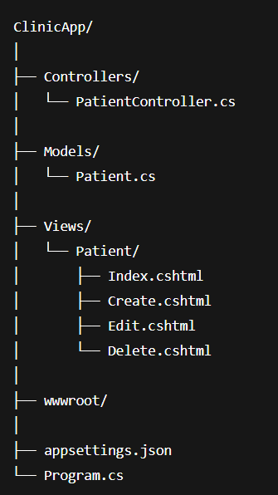
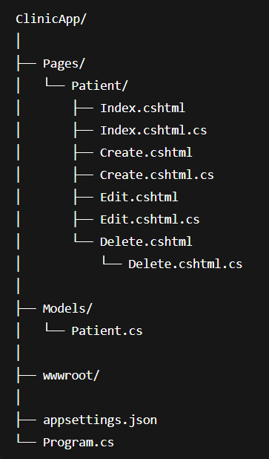
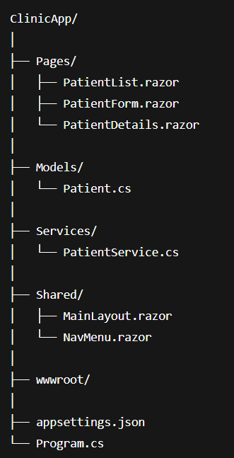
Typical Folder Layouts
MVC
Pages
Blazor

Slide 7
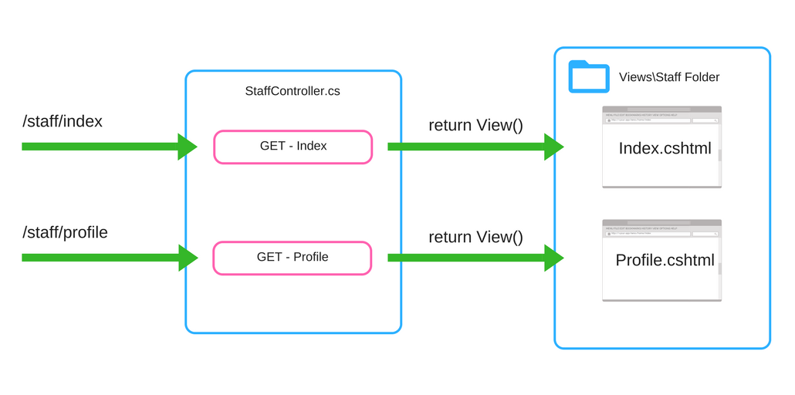
Request Flow – MVC

Slide 8
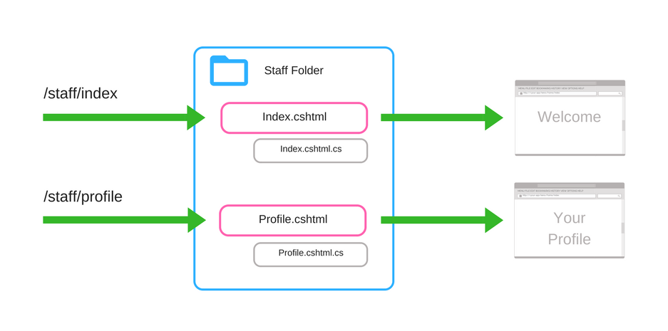
Razor Pages Flow

Slide 9
Pros & Cons
MVC
👍 Mature, flexible, great for complex scenarios
👎 Can lead to large controllers
Razor Pages
👍 Intuitive, low magic, focused on single-page responsibility
👎 Less suited for multi-view or API-driven logic
Blazor
👍 Full C# in the browser, ideal for interactive apps
👎 SEO & routing issues (especially WebAssembly); newer tech

Slide 10
MVC Pattern

Slide 11
What is MVC?
MVC stands for Model‑View‑Controller
Model: Handles data and business logic (e.g., Patient class).
View: Displays UI, written in Razor (.cshtml).
Controller: Responds to user actions and coordinates Model & View.
MVC pattern helps maintain organized, scalable, and testable code.

Slide 12
MVC Component Responsibilities
Component | Role | Clinic Example
Model | Data & rules | Patient.cs defines patient properties
Controller | Request handler | PatientController.cs processes CRUD
View | UI rendering | Index.cshtml, Create.cshtml, etc.

Slide 13
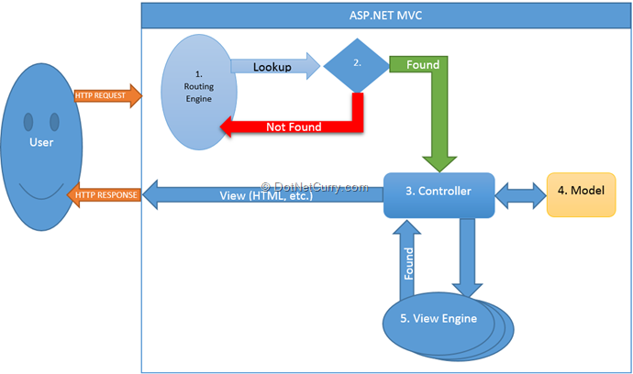
MVC Request Flow

Slide 14
MVC Best Practices
Keep controllers thin; delegate logic to services or the model layer
Follow clear naming conventions: PatientController, corresponding Views
Keep Views limited to presentation logic
Avoid database access or business logic in Views themselves

Slide 15
Creating Controllers and Actions

Slide 16
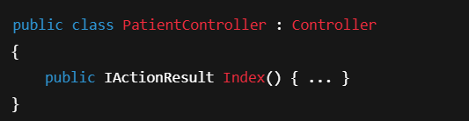
What is a Controller?
A Controller is a C# class that:
Handles HTTP requests
Interacts with the Model
Returns a View or JSON result
🧠 Each public method = Action

Slide 17
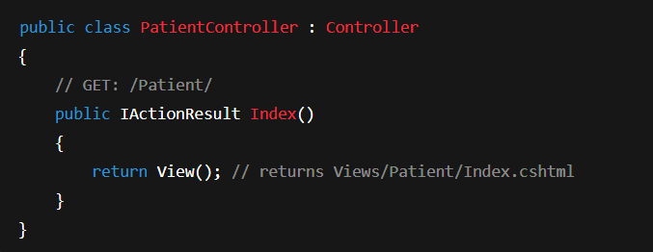
PatientController – Example Setup
📁 Location: Controllers/PatientController.cs
📝 Controller name + Action name → default routing.

Slide 18
Action Methods and Routing
URL Path | Controller | Action Method
/Patient | PatientController | Index()
/Patient/Create | PatientController | Create()
/Patient/Edit/5 | PatientController | Edit(int id)
/Patient/Delete/5 | PatientController | Delete(int id)
📌 By default: /ControllerName/ActionName/{id?}

Slide 19
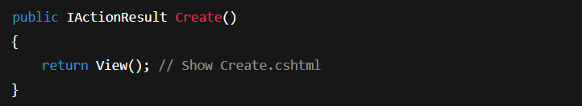
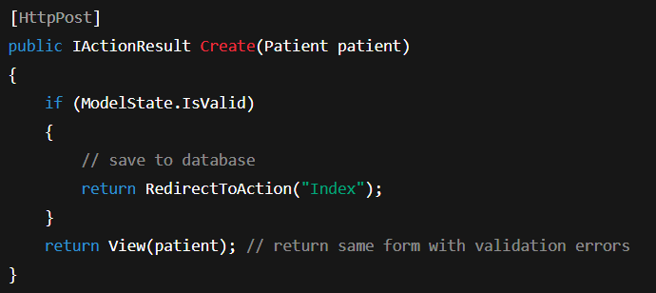
Creating a Basic Action Method
🔧 Display a patient registration form:
📨 Handle form submission:

Slide 20
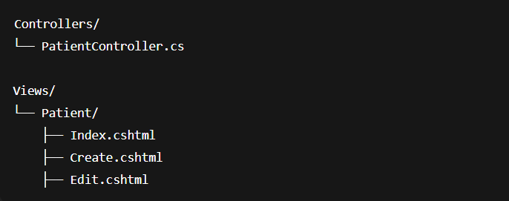
Controller and Views Relationship
📁 Folders should match Controller name
📄 View file names match Action methods

Slide 21
References
https://jonhilton.net/razor-pages-or-mvc-a-quick-comparison/
https://stackify.com/asp-net-razor-pages-vs-mvc

Slide 22
شــــــكــــرًا لكــــــم
THANK YOU

